Slide 1
Computer ARCHITECTURE (CA)
Course Instructor
Hira beenish
Department of Computer Science

Slide 2
Computer ARCHITECTURE
Computer Architecture Is Concerned With The Structure & Behavior Of Computer As Seen By The User
It Includes The Information Format, The Instruction Set & Techniques For Addressing Memory

Slide 3
Course Instructor
Hira Beenish
Permanent Lecturer at PAF-KIET
Email: Hira@pafkiet.edu.pk
MS( Telecommunication & Networking) from BUKC
BS (Telecommunication) from FUUAST

Slide 4
Course Information
Name: Computer Architecture (CA)
Pre req: BE, DLD & COAL

Slide 5
Marking Scheme
4 quizzes 10 marks
2 Assignments 05 marks
1 Project 15 marks
Mid-term Exam 20 marks
Final Exam 40 marks
Lab exam 10 marks

Slide 6
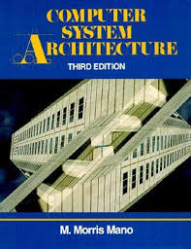

Recommended Books
Computer Systems Architecture, 3rd Edition
By M.Morris Mano; Prentice Hall International
Computer Organization and Architecture Designing For Performance By William Stallings

Slide 7
Computer architecture
The overall design or structure of a computer system, including the hardware and the software required to run it, especially the internal structure of the microprocessor
Computer architecture is a view of the whole design with the important characteristics

Slide 8
Chapters Included
1. Digital logic circuits
2. Digital components
3. Data Representation
4. Register transfer
5. Basic Computer Organization & Design →→Mid Term
6. Central processing unit
7.Pilpeline & vector processing
8. Computer arithmetic
9. I/O & O/P organization
10. Memory organization
11. Multiprocessors

Slide 9
Chapter#1 Digital logic circuits

Slide 10
Contents
Digital Computers
Logic Gates
Boolean Algebra
Map Simplification
Combinational Circuits
Flip Flops
Sequential Circuits

Slide 11
Digital logic circuits
Digital Computers
The digital computer is a digital system that performs various computational tasks.
Digital computers use the binary number system, which has two digits 0 & 1
Binary digit is called a Bit. Information is represented in digital computers in group of Bits.
The group of Bits are used to develop complete sets of Instructions for performing various types of computations.
In other words group of Bits in a digital computer are used to represent many things.

Slide 12
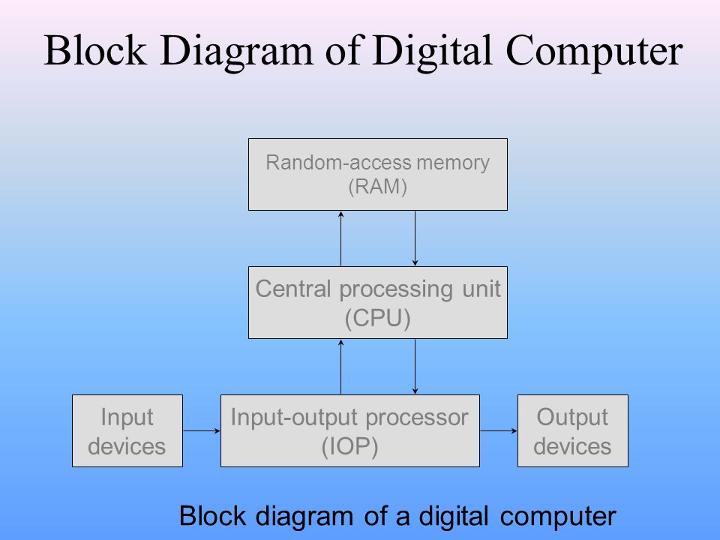
Computer Hardware
The hardware of the computer is divided into three major parts as shown in figure
I/P 0/P Processor
Central Processing Unit
Random Access Memory

Slide 13
Logic gates
The logic gate is the basic building block from which all digital electronic circuits and microprocessor based systems are constructed from.
In digital logic design only two voltage levels or states are allowed and these states are generally referred to as Logic “1” and Logic “0”, High and Low, or True and False

Slide 14
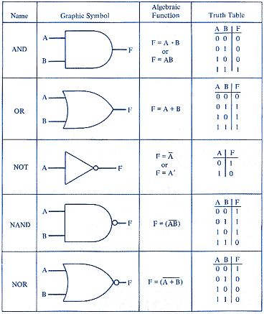

Slide 15
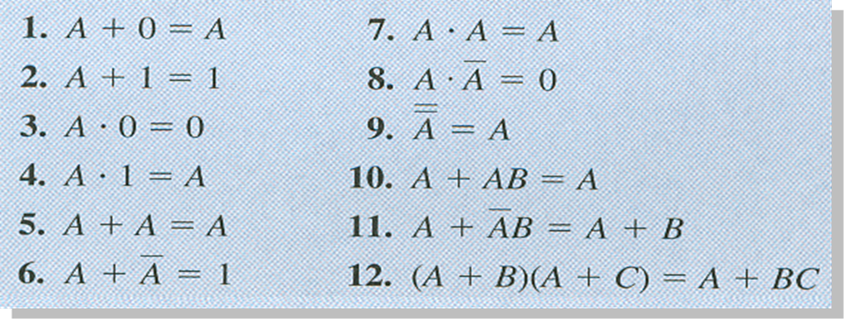
Boolean algebra
Boolean algebra is an algebra that deals with binary variables and logic operations
Rules of Boolean Algebra

Slide 16
DeMorgan’s Theorems
Theorem 1
Theorem 2

Slide 17
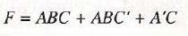
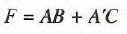
Boolean algebra
Draw the Circuit diagram

Slide 18
Karnaugh map

Slide 19
Karnaugh map
The Karnaugh Map Also Known As K Map
It Is A Two Dimensional Form Of The Truth Table
The Map Is A Diagram Made Up Of Squares, Each Square Represent One Minterm
The Simplification Of Boolean Expression Can Be Immediately Be Seen From The Location Of 1’s In The Map.
Karnaugh Maps Can Be Used For Expressions With Two, Three, Four. And Five Variables
For Three Variables, The Number Of Cells Is 23 = 8. For Four Variables, The Number Of Cells Is 24 = 16.

Slide 20
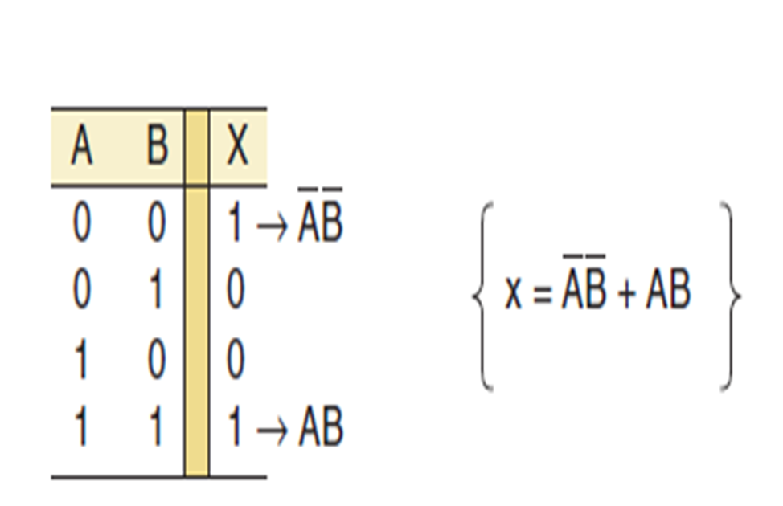
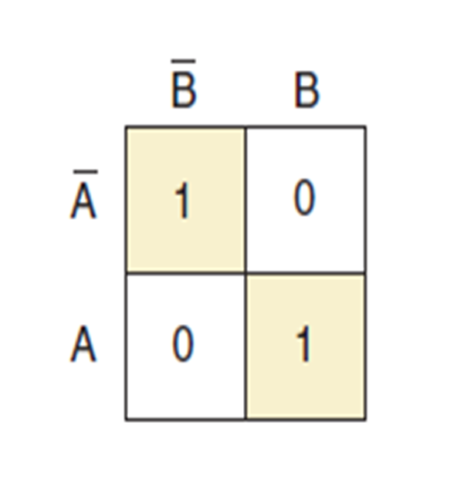
Karnaugh map
K Maps For Two Variables,
Each Case In The Truth Table Corresponds To A Square In The K Map

Slide 21
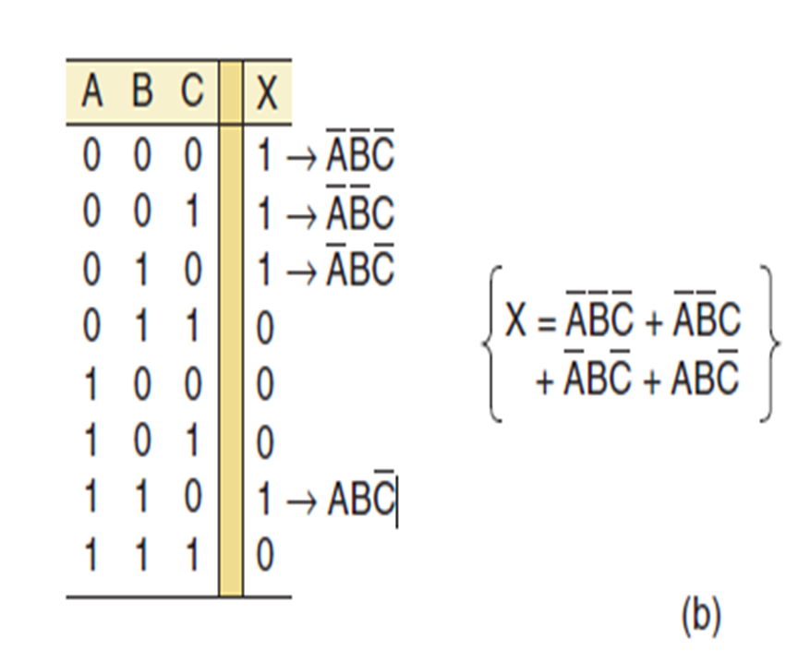
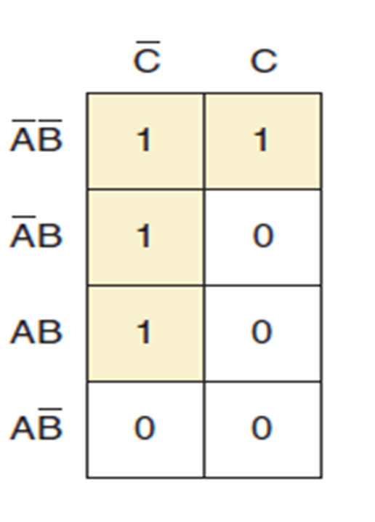
Karnaugh map
K maps for three variables

Slide 22
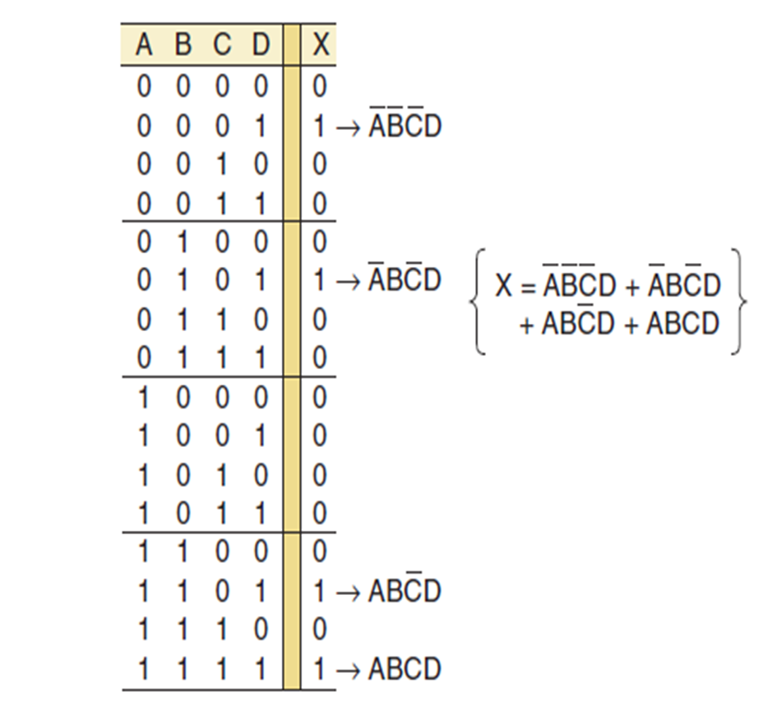
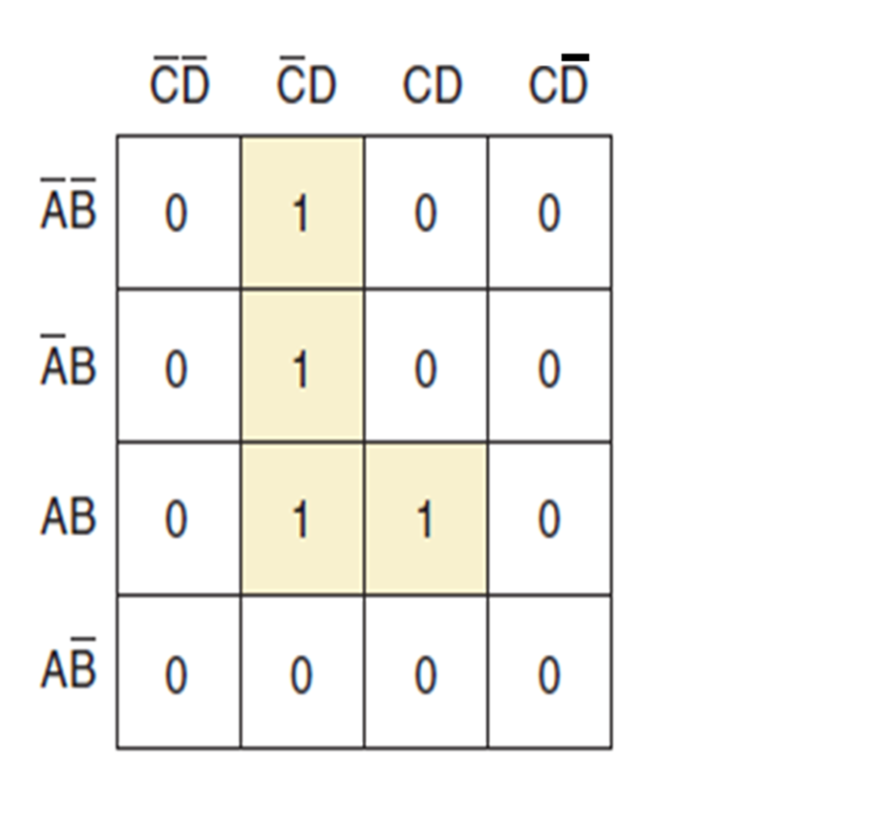
K MAPS FOR FOUR VARIABLES
K maps for four variables

Slide 23
Karnaugh Map Simplification
The process that results in an expression containing the fewest possible terms with the fewest possible variables is called minimization.
A minimum SOP expression is obtained by grouping the 1s and determining the minimum SOP expression from the map.
You can group 1s on the Karnaugh map according to the following rules
A group must contain either 1, 2, 4, 8, or 16 cells, which are all powers of two. In the case of a 3-variable map, 23 = 8 cells is the maximum group.
Each cell in a group must be adjacent to one or more cells in that same group, but all cells in the group do not have to be adjacent to each other.
Always include the largest possible number of 1s in a grou

Slide 24
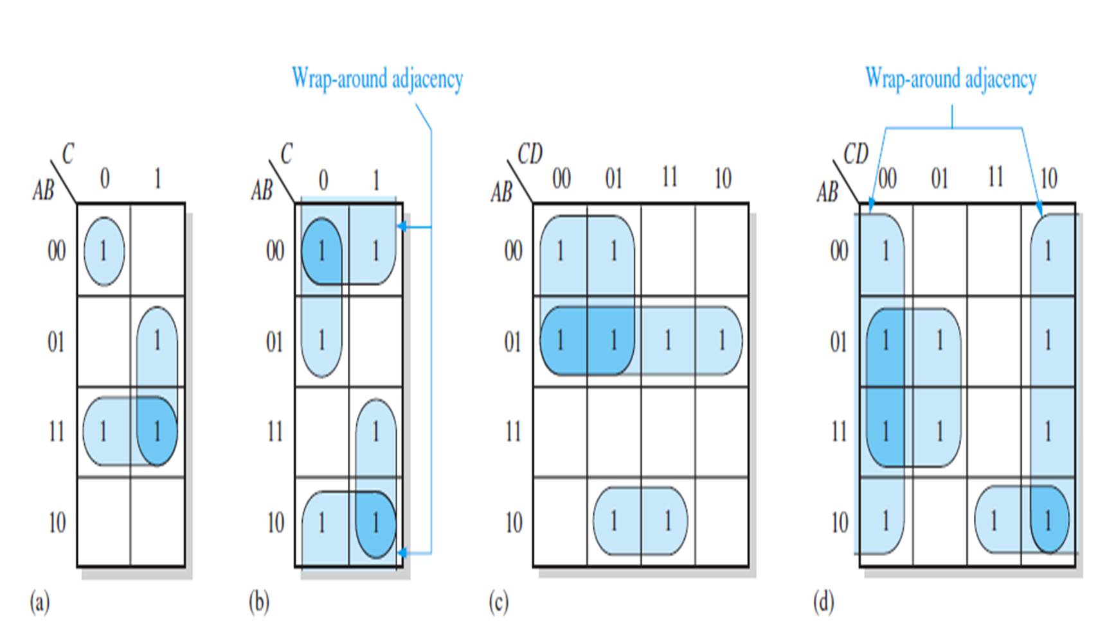

Slide 25
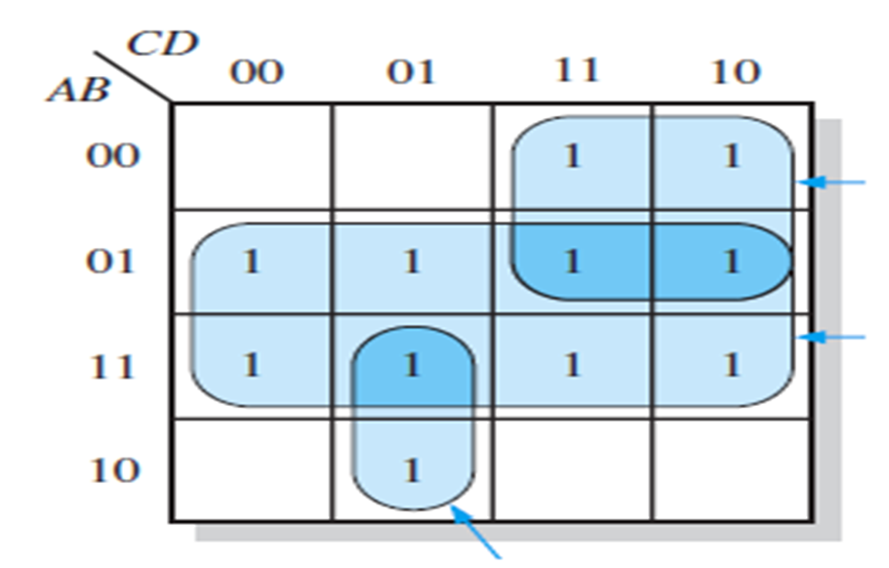
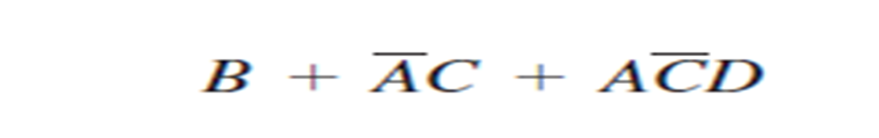
Karnaugh Map Simplification
Determine the product terms for the Karnaugh map in Figure and write the resulting minimum SOP expression

Slide 26
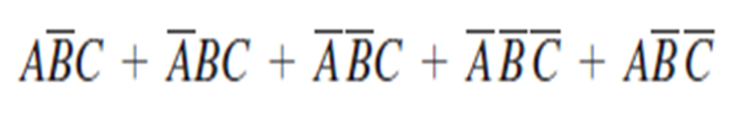
Karnaugh Map Simplification
Use A Karnaugh Map To Minimize The Following Standard SOP Expression

Slide 27
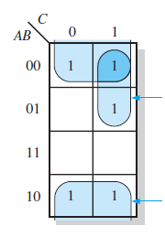
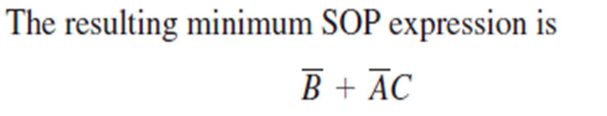
Karnaugh Map Simplification

Slide 28
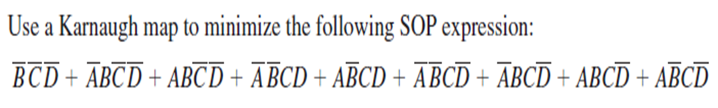
Karnaugh Map Simplification

Slide 29
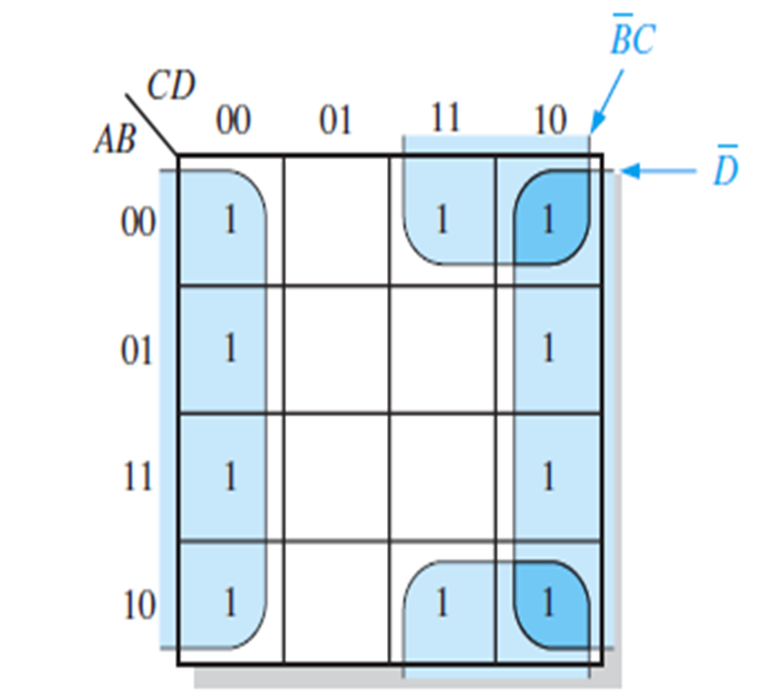
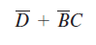
Karnaugh Map Simplification

Slide 30
Combinational Logic Analysis

Slide 31
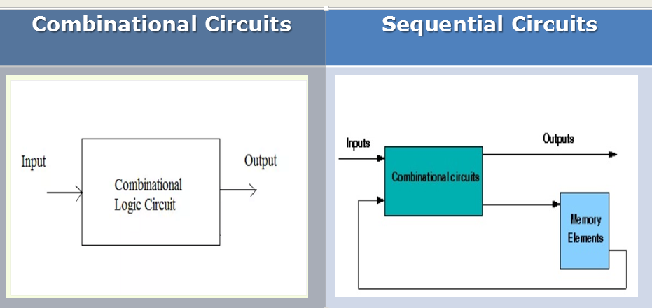
Combinational Logic Analysis

Slide 32
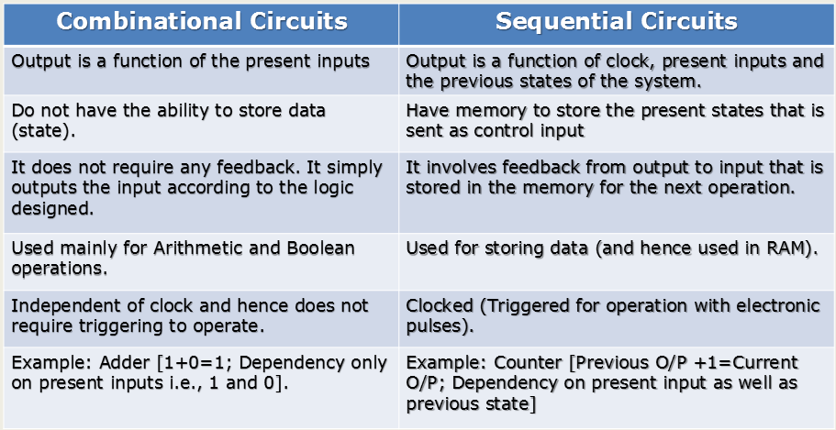

Slide 33
Combinational Logic Analysis
To Demonstrate The Design Of Combinational Circuit, present two examples of simple arithmetic circuits
Half Adder
Adders Are Important In Computers And Also In Other Types Of Digital Systems In Which Numerical Data Are Processed
An Understanding Of The Basic Adder Operation Is Fundamental To The Study Of Digital Systems
Basic Rules Of Binary Addition Are Performed By A Half Adder, Which Has Two Binary Inputs (A And B) And Two Binary Outputs (Carry Out And Sum).

Slide 34
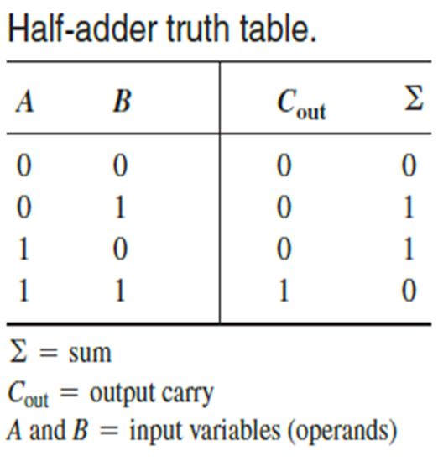
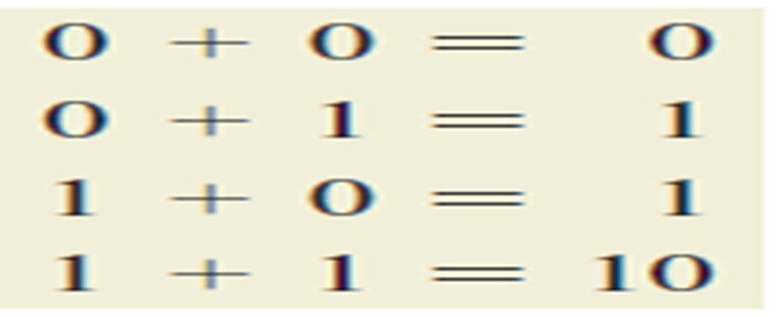
The Half-Adder
Recall the basic rules for binary addition

Slide 35
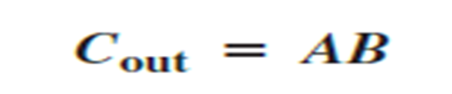
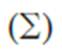
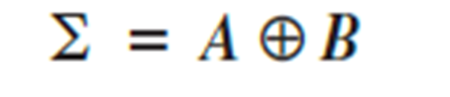
Half-Adder Logic
From the operation of the half-adder as stated in Table expressions can be derived for the sum and the output carry as functions of the inputs.
Notice that the output carry (Cout) is a 1 only when both A and B are 1s; therefore,
Cout can be expressed as the AND of the input variables.
Now observe that the sum output is 1 only if the input variables, A and B, are not equal. The sum can therefore be expressed as the exclusive-OR of the input variables.

Slide 36
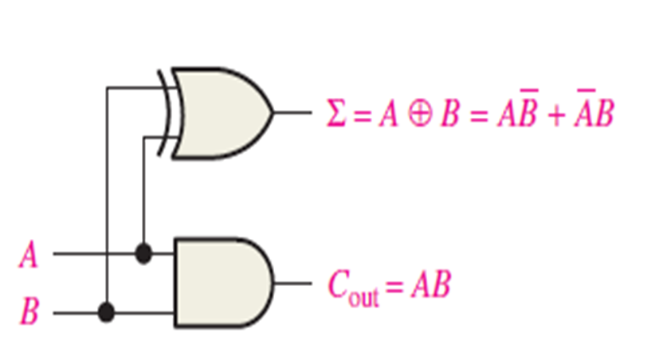

Slide 37
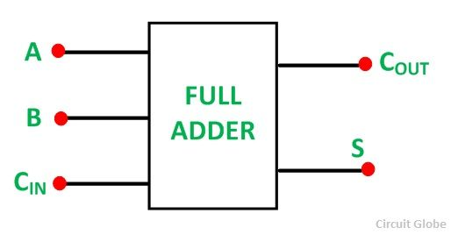
The Full-Adder
The full-adder accepts two input bits and an input carry and generates a sum output and an output carry.
The basic difference between a full-adder and a half-adder is that the full-adder accepts an input carry
logic symbol for a full-adder is shown in Figure

Slide 38
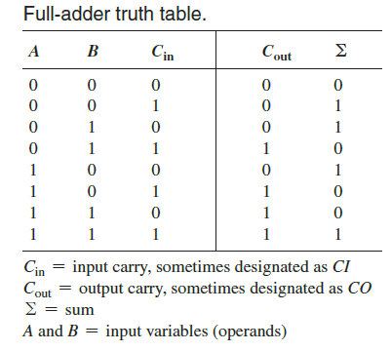
The Full-Adder

Slide 39
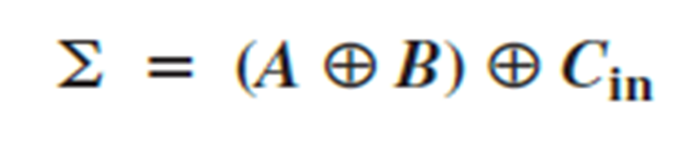
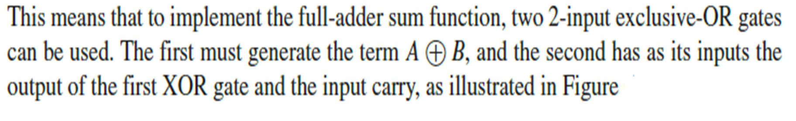
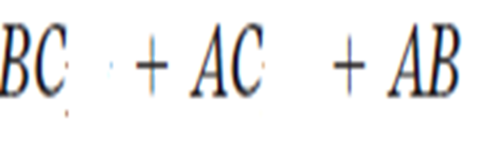
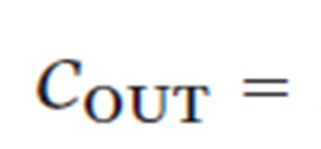
Full-Adder Logic
The full-adder must add the two input bits and the input carry.
From the half-adder you know that the sum of the input bits A and B is the exclusive-OR of those two variables.
A exclusive B. For the input carry (Cin) to be added to the input bits, it must be exclusive-Ored with AB, yielding the equation for the sum output of the full-adder.

Slide 40
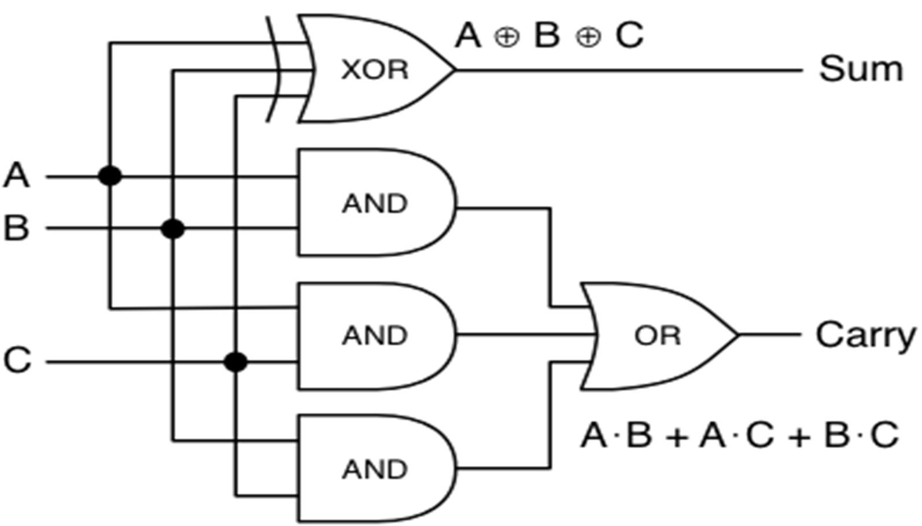
Full-Adder

Slide 41
Latches & flip Flop

Slide 42
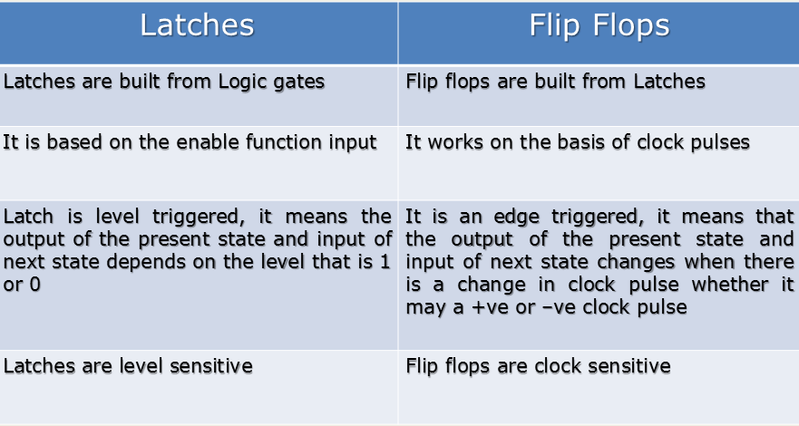
Difference between Latches and Flip Flops

Slide 43
Latches
A latch is a temporary storage device that has two stable states (bistable)
It is a basic form of memory.
Bistable devices have two stable states, called SET and RESET

Slide 44
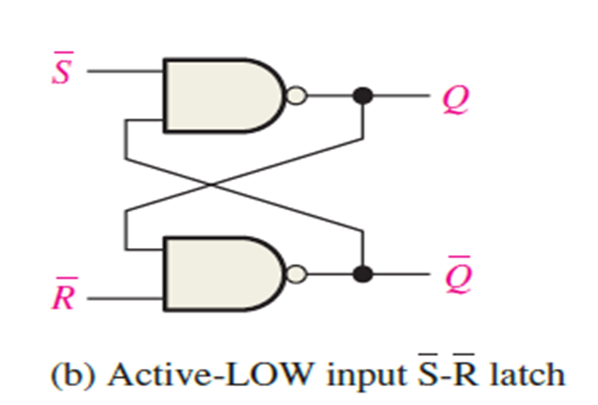
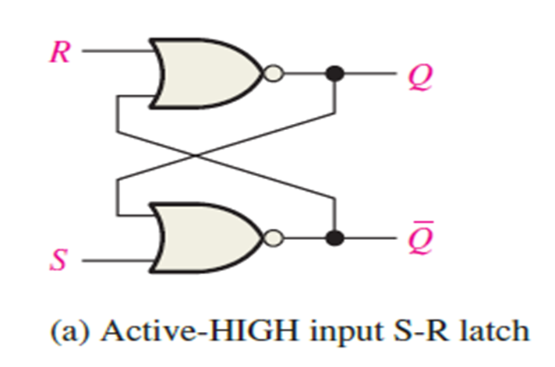
The S-R (SET-RESET) Latch
The S-R (Set-Reset) latch is the most basic type of memory
It can be constructed from NOR gates or NAND gates
With NOR gates, the latch responds to active-HIGH inputs
With NAND gates, it responds to active-LOW inputs

Slide 45
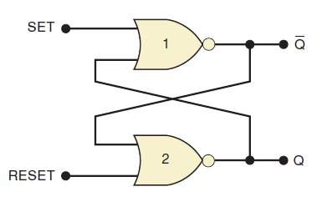
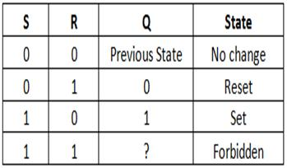
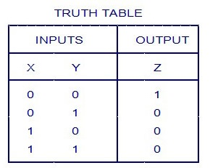
The S-R (SET-RESET) Latch

Slide 46
Flip flops
Clock: The exact times at which any output can change states are determined by a signal commonly called the Clock
Triggering: This means making a circuit active.
Making a circuit active means allowing the circuit to take input and give output
When the circuit is not triggered, even if you give some input data, it will not change the data stored inside the flip-flop nor will it change the output Q or Q'

Slide 47
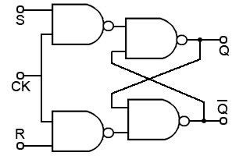

Slide 48
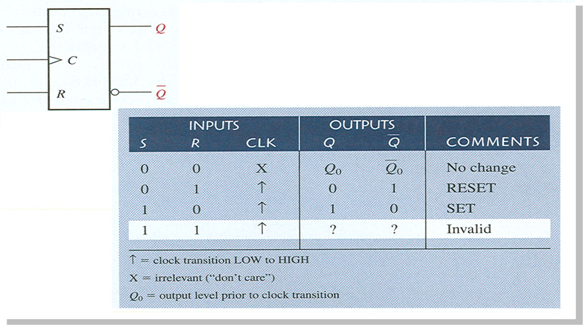
S-R flip-flop

Slide 49
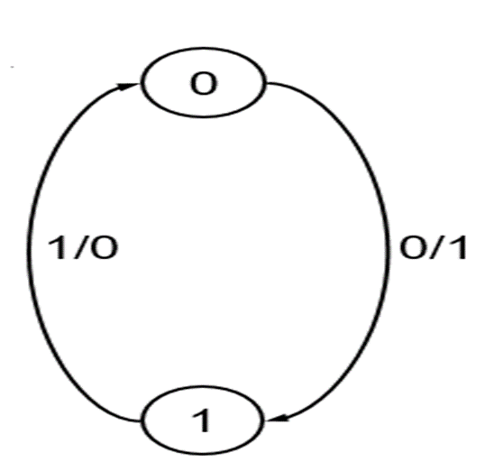
State Diagrams
The information in a state table is represented graphically in a state diagram
A state is represented by a circle transitions between states are represented by directed lines connecting the circles (states)
Binary number inside the circle identifies the state of the flip-flops
The directed lines are labeled with two binary numbers separated by a slash
The number before the slash indicates the input and number following the slash indicates the output

Slide 50
Thank You

